Slide 1
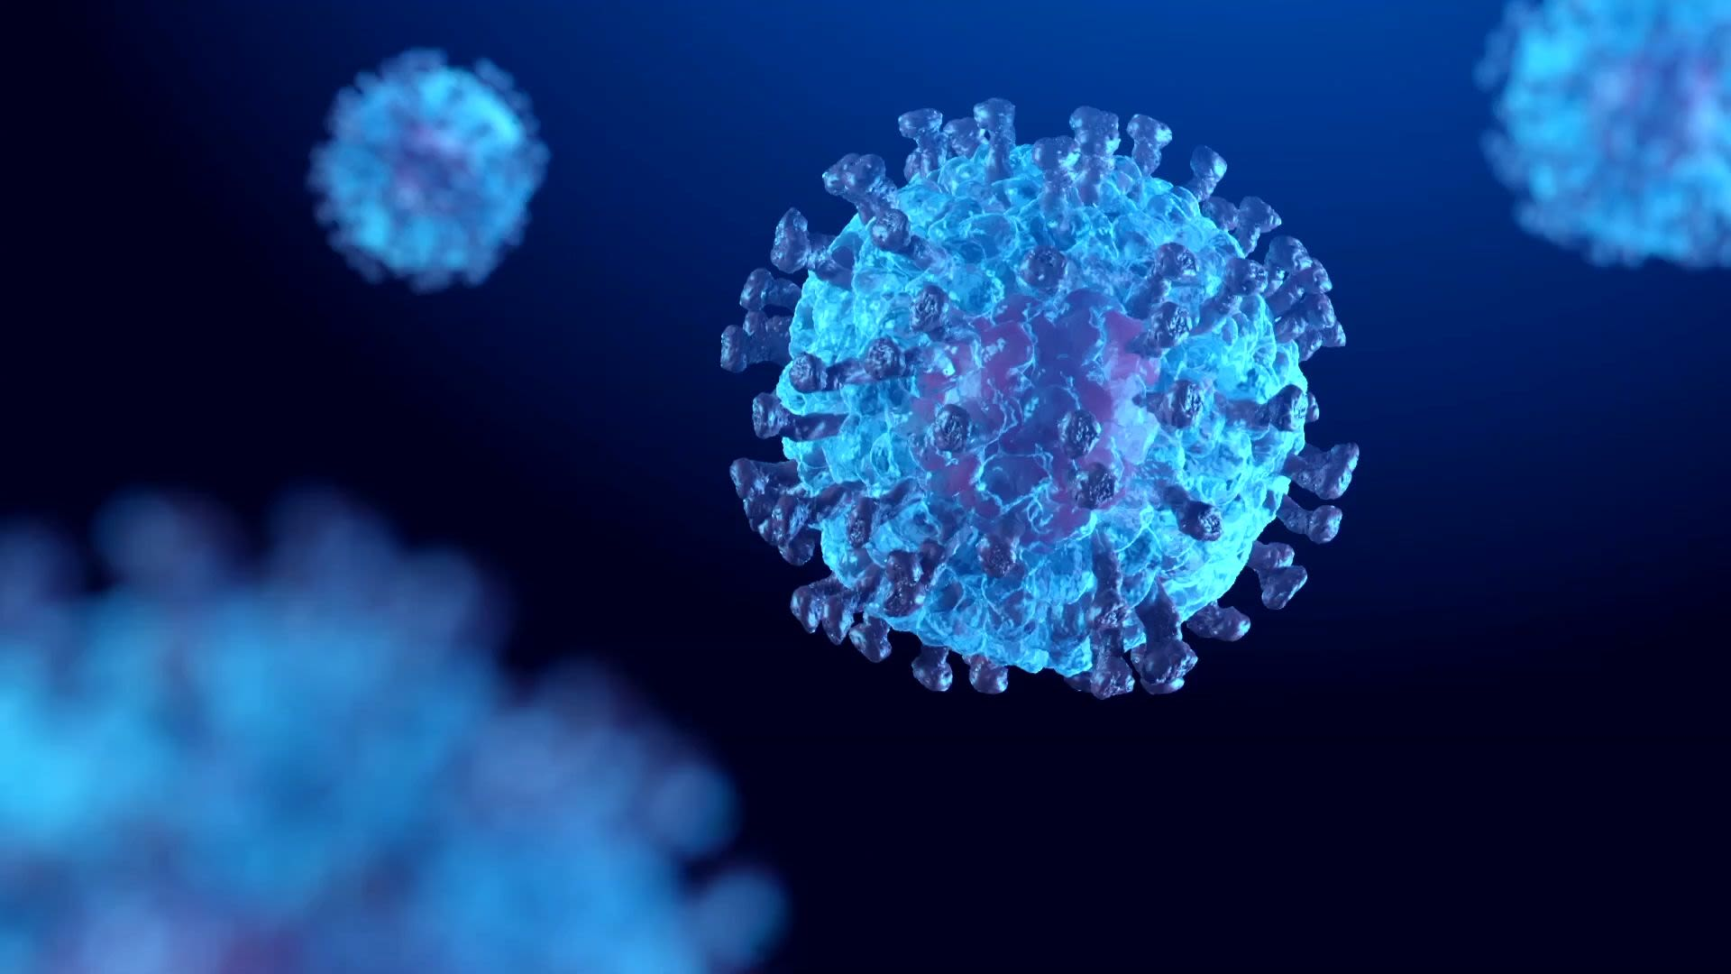
Covid Information App
Brainstormers

Slide 2
Team members responsibilities
Project Management & System Administrator(Team Lead) - Vaishnavi Mandadi
Requirements & Documentation Lead- Sahit Reddy Chinthakuntla
Design & Testing Lead- Aishwarya Yadav Jala
Implementation Lead(front end)- Akshaya samepalli
Implementation Lead(Back end)- Kiran Jyothi Bodduluri
Configuration Management Lead- Rajasekhar Reddy Moddu
Demo and Presentation Lead- Venkata Sai Reshma Kallepalli

Slide 3
Things to discuss:
Project description
Phases
Core Requirements
Functional and Non-functional requirements
Implementation
Testing
Feedback from peer reviews
Code inspection results
Limitations

Slide 4
Project Description
People from all over the world were impacted by the global COVID-19 epidemic. This has evolved into an outbreak as a result of the pandemic, and a sizeable population was impacted. The only ways to defeat it are through the creation of vaccines, preventative measures, and awareness. The software we develop will help to educate others in some ways. In this application user can login into the application and check the nearby positive cases, world wide cases, update the profile of a user, can get the required precautions, helpline numbers. User can donate the money or clothes if required. User can find the vaccination centers, covid Certificate of the user if required.

Slide 5
Phases
We have three phases in this plan as the parts of the project.
1.We implemented User login, registration and Dashboard in the phase 1 of the project.
2. We have implemented Admin web page, Covid Survey, Precautions, Donations, Helpline tabs in the dashboard in the phase 2 of our project.
3. We have implemented Profile, Covid cases, Nearby Positive cases, Vaccination center, Covid Certificate tabs in the phase 3 of our project.

Slide 6
Core Requirements
HARDWARE REQUIREMENTS
Intel i5 process and above,
RAM 8 GB and above,
HD 500 GB and above,
GPU GTX 1080 and above
SOFTWARE REQUIREMENTS
Android studio, JDK is used to develop an android application. For implementation of Front End Language, XML is used.

Slide 7
Functional & Non- Functional Requirements
Functional requirements:
Firstly, User must be registered for the app. For that name, gender, age is required and a signup module is required.
It allows you to see COVID detected cases in all over world and state wise cases in real-time.
A health survey for the users is conducted in the app.
If any of the user is tested positive, it will update the positive result in the Covid app.
If any of the user is tested positive, it will give precautions accordingly.
In user and volunteer forums, we will give links where user or volunteer can donate or contribute goods like food, clothing and medicines.
In case of any emergency or urgency, helplines and government organizations are provided.
Non-functional requirements:
The program should be able to manage user data (caches, saved data, etc. without delay by optimizing how storage is done and accessed.
To compare all authentication tokens, they should be saved locally on the device, and access requires user authorization.
To avoid further marginalization and prejudice, digital monitoring must address this potential downside.
Data sharing with other parties should be regulated by legislation to ensure privacy, prevent misuse, and provide people a voice in cases of misconduct.
Using MySQL for Security and privacy of data.
The user should be able to review the app and make essential contacts through the app.

Slide 8
Implementation
we Implemented the following tabs in our project:
Login tab
Register tab
Dashboard
Admin tab
Covid survey tab
Precautions tab
Donations tab
Helpline tab

Slide 9
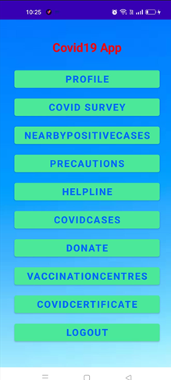
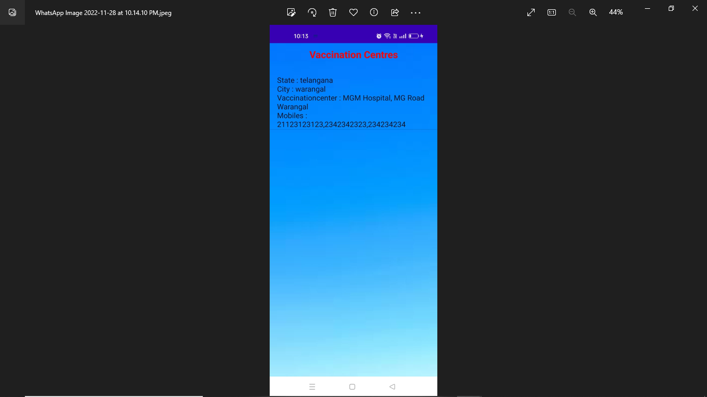
Functionalities
User Dashboard:
Nearby vaccination centers:

Slide 10
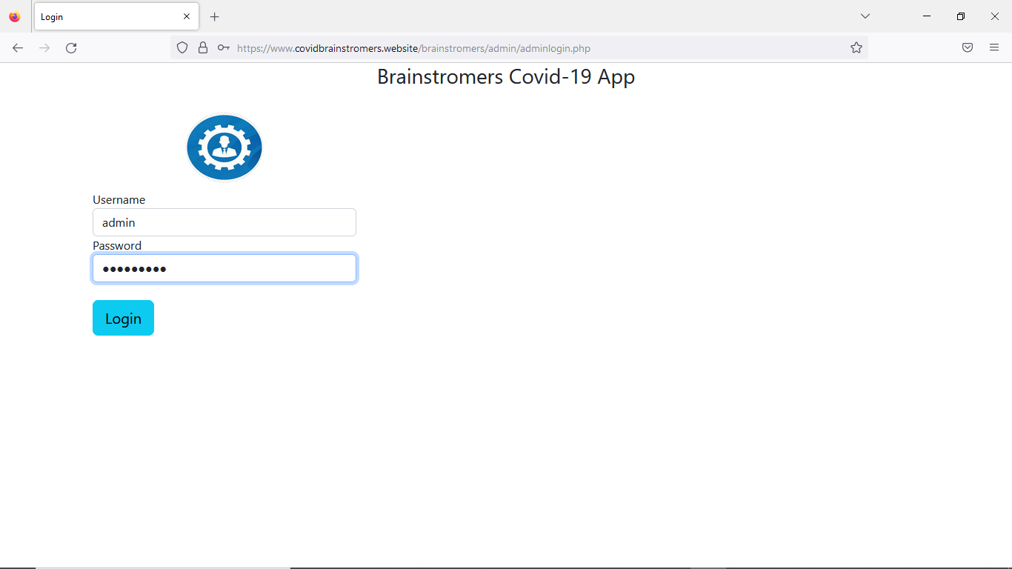
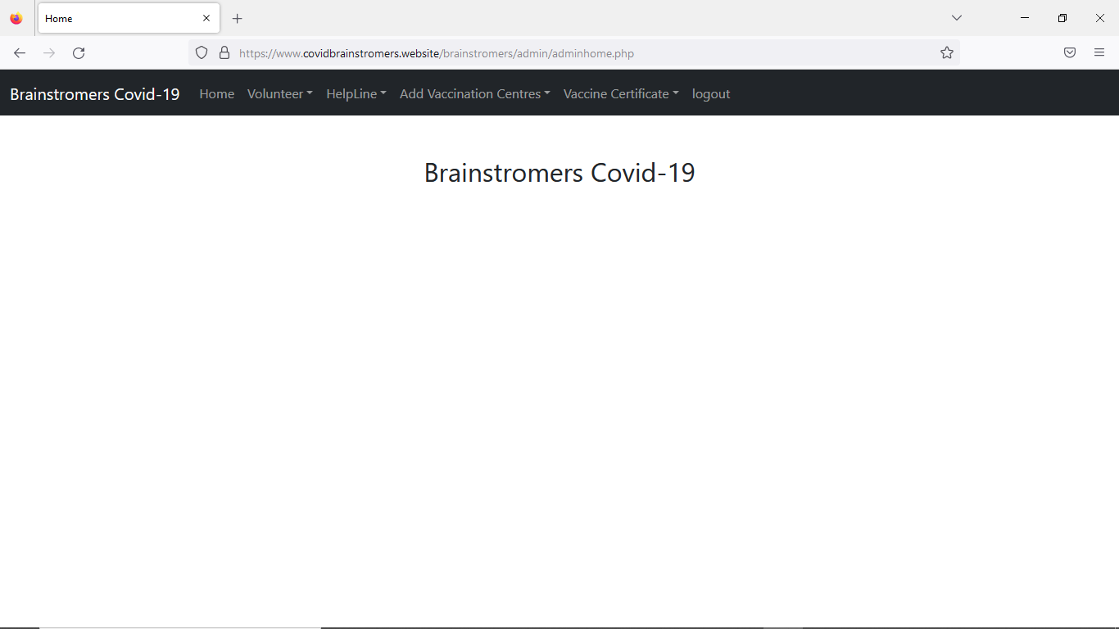
Functionalities
Admin login page:
Admin home page:

Slide 11
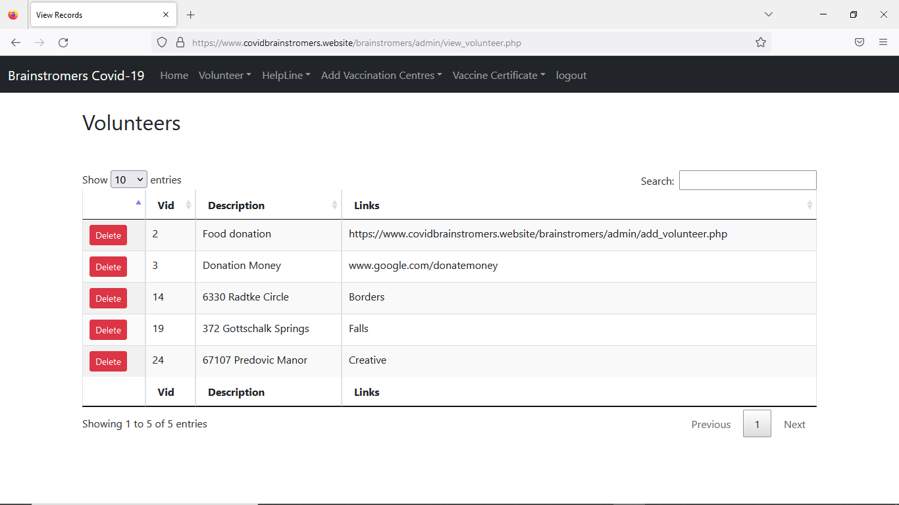
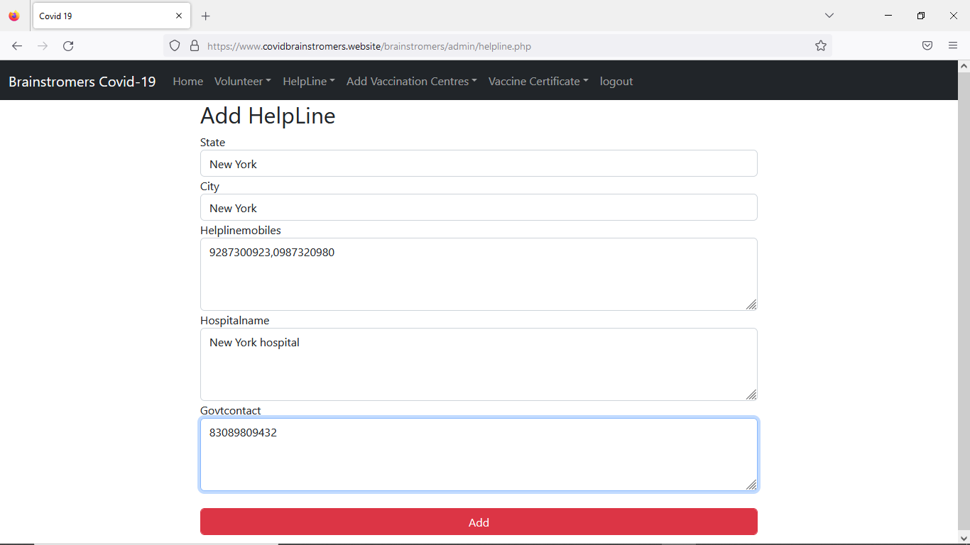
functionalities
Shows voluteers:
Adds helpline numbers:

Slide 12
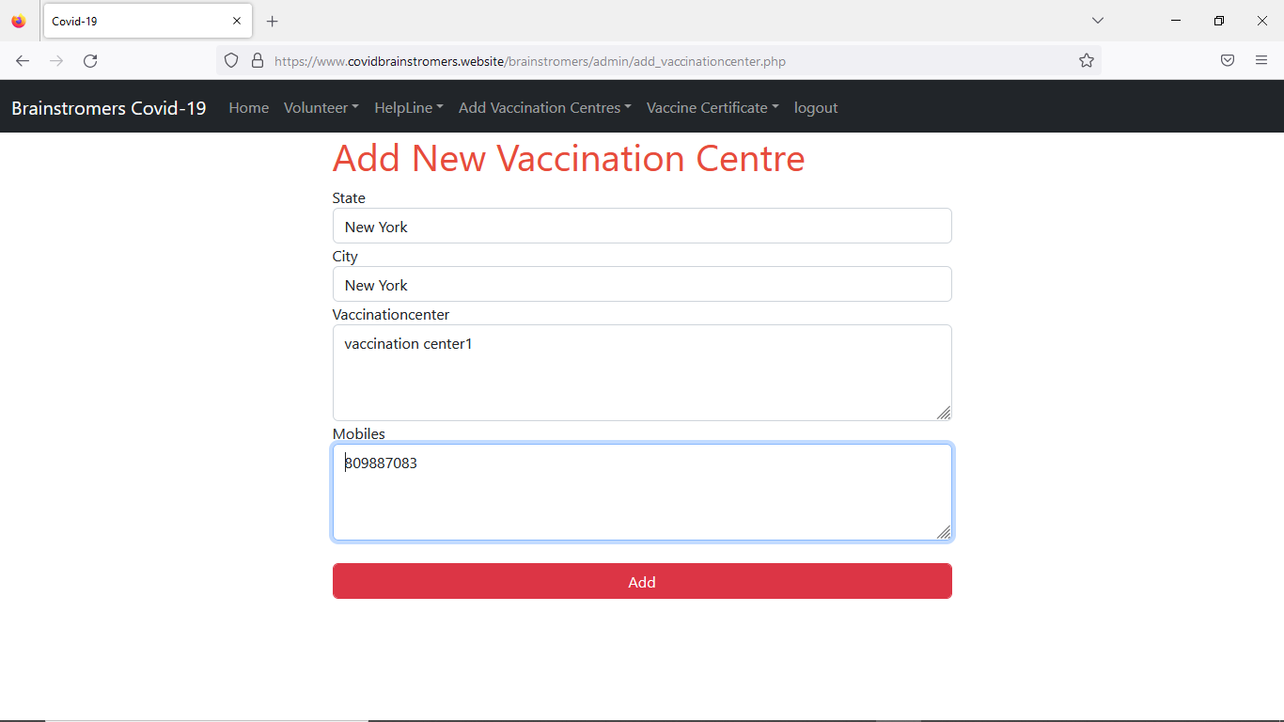
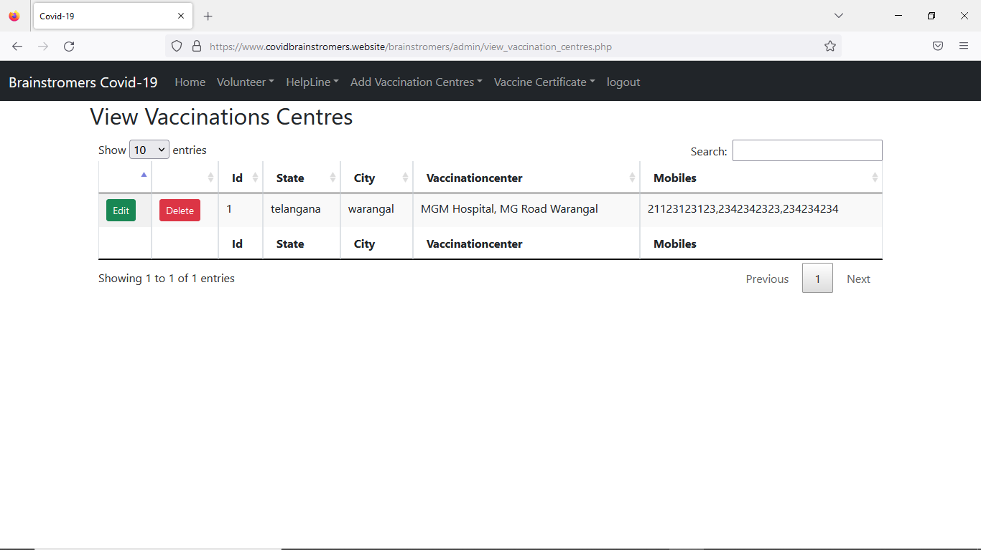
functionalities
Adds vaccination centers by admin
Shows all vaccination centers:

Slide 13
Testing
USER REGISTRATION
Here the user will provide the details like name, gender, age, mobile number, user name and password.
Expected Output = Registration Successful.
Actual Output = Registration Successful.
Result = Success.
USER LOGIN
Here the user will enter the user name and password.
After entering the data by the user the server checks the data and validates the user data.
Expected Output = Login Successful.
Actual Output = Login Successful.
Result = Success.
DASHBOARD
Here we can see the dashboard of the covid application.
Expected Output = Dashboard Successful.
Actual Output = Dashboard Successful.
Result = Success.
COVID SURVEY PAGE
Here we are displayed with the dashboard of covid application center. After entering it displays the fields that are to be filled in the covid survey page.
expected Output = Covid Tested Postive.
Actual Output = Covid Tested Positive.
Result = Success.
NEARBY POSITIVE CASES
Here it shows the nearby positive cases.
Expected Output = List of covid patients.
Actual Output = List of covid patients.
Result = Success.
PRECAUTIONS
Here it shows the precautions that are to be taken.
Expected Output = Covid Precautions.
Actual Output = Covid Precautions.
Result = Success.
COVID CASES
Here we will select the state and the city which helps in displaying the positive cases based on the location.
Expected Output = Real Time Covid Cases Data.
Actual Output = Real Time Covid Cases Data.
Result = Success
.HELPLINE NUMBERS
Here we can get the emergency contact numbers when required.
Expected Output =Helpline Contact Numbers.
Actual Output = Helpline Contact Numbers.
Result = Success.

Slide 14
Testing
COVID CERTIFICATE
Here it shows the covid certificate of the user who is tested positive.
Expected Output =Covid Certificate.
Actual Output = Covid Certificate.
Result = Success.
ADMIN LOGIN
Here the admin will enter the details like username and password which checks and validates the data.
Expected Output = Admin Login Successfull.
Actual Output = Admin Login Successfull.
Result = Success.
ADMIN ADD VOLUNTEERS
Here the admin will add the volunteers who are ready for the help in the application then the required users can contact them.
Expected Output = Volunteers Added.
Actual Output = Volunteers Added.
Result = Success.
ADMIN ADD VACCINATION CENTERS
Here the admin can add the details of vaccination centers.
Expected Output = Vaccination Centers Added.
Actual Output = Vaccination Centers Added.
Result = Success.
ADMIN ADD HELPLINE CONTACTS
Here the admin can add the helpine contacts.
Expected Output = Helpline Contacts Added.
Actual Output = Helpline Contacts Added.
Result = Success
ADMIN ADD VACCINATION CENTERS
Here the admin can add the details of vaccination centers.
Expected Output = Vaccination Centers Added.
Actual Output = Vaccination Centers Added.
Result = Success.

Slide 15
Feedback from peer reviews
The have given us an idea about implementing covid certificate verification for the users.
Discussed about performance issues.
We have to work on functional requirements
They asked about the framework we used to implement this project.
Time management.
we have to focus more on implementation of functional and non- functional requirements that we mentioned earlier.

Slide 16
Code Inspection
Questions asked
1.explain about your front end code and where is it written in android studio?
In our application we have written the UI code in .xml files , it contains tags which are to be revoked while implementation
2.What is your phase 1 implementation and what have you covered?
We have done the user registration page , login page and dashboard page in our phase one, we successfully set up the connection with the server and made our application run on android studio.
3.How you implemented the frontend pages?
Using the xml files to connect the front end to the back

Slide 17
Code Inspection
4.How does your intent function work?
Intent is the description of an operation to be performed. We use like start activity to launch the activity. We can build connections between frontend and backend.
5.What is the toast function used for?
Toast is a class to give the popups like warnings we will use maketest() function for that. These are the queries raised by the raptors team , we have showed our project code and explained the details to them and we have to still work on improving the ui design and other functions.

Slide 18
Code Inspection
Suggestions From Peers:
They said us to implement covid certificate verification for the users.

Slide 19
Limitations
The app is constrained to work correctly when we enter the right credentials to login to the application.
In this app we have included locations, maps successfully. But it took lot of time to complete this for successfully implementation.
The limitation of app is that the user is not posted with how many vaccines he already taken and next doses information.
In donation module just we are providing the url to organinsation who take donations but verification of these organization is not implemented.

Slide 20
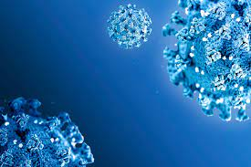
THANK YOU

